Slide 1

DS5220 Project Final Presentation
Market Analysis of
S&P 500 Index
Sai Nikhil Kunapareddy and Dilep Shetty Ittanguru Venkatesh

Slide 2

DS5220 Project Final Presentation
Market Analysis of
S&P 500 Index
Sai Nikhil Kunapareddy and Dilep Shetty Ittanguru Venkatesh
Objective(s)
Understanding time series forecasting
Comparing statistical and machine learning methods
Analyze limitations in forecasting techniques

Slide 3
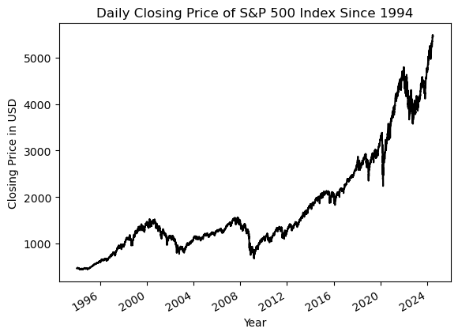
Market Analysis of
S&P 500 Index
Sai Nikhil Kunapareddy and Dilep Shetty Ittanguru Venkatesh
Objective(s)
Understanding time series forecasting
Comparing statistical and machine learning methods
Analyze limitations in forecasting techniques
Data Overview

Slide 4

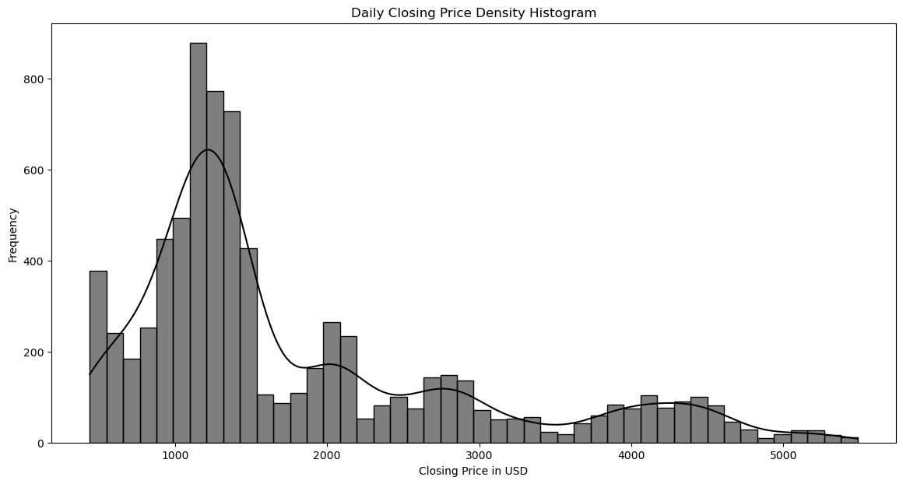
Objective(s)
Understanding time series forecasting
Comparing statistical and machine learning methods
Analyze limitations in forecasting techniques
Data Overview
Density Plot

Slide 5
Data Overview
Machine Learning Models
Density Plot
ARIMA
SARIMA
LSTM
PROPHET

Slide 6
Density Plot
Machine Learning Models
AutoRegressive
ARIMA
Integrated
SARIMA
Moving Average
LSTM
PROPHET

Slide 7
Machine Learning Models
ARIMA
AutoRegressive
Integrated
Moving Average
SARIMA
LSTM
PROPHET

Slide 8
ARIMA
AutoRegressive
Integrated
Moving Average
SARIMA
Seasonal
AutoRegressive
Integrated
Moving Average
LSTM
PROPHET

Slide 9
SARIMA
Seasonal
AutoRegressive
Integrated
Moving Average
LSTM
Long
Short-Term
Memory
PROPHET
Open Source
Meta’s Data Science Team

Slide 10
LSTM
Long
Short-Term
Memory
PROPHET
Open Source
Meta’s Data Science Team
Model
Evaluation

Slide 11
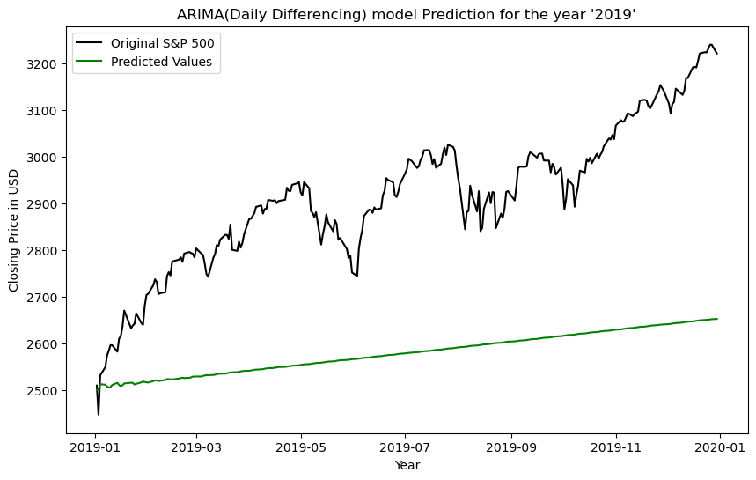
PROPHET
Open Source
Meta’s Data Science Team
ARIMA
Model
Evaluation

Slide 12
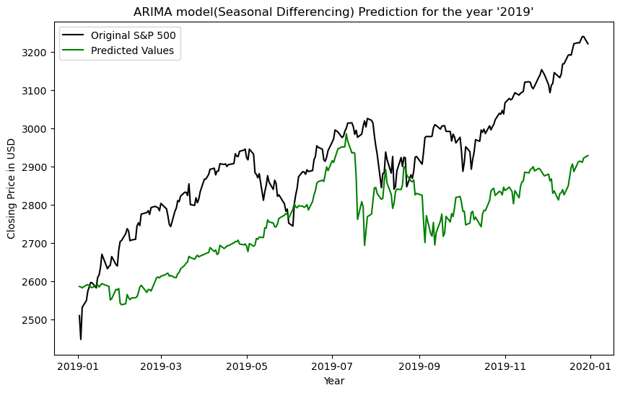
ARIMA
Model
Evaluation

Slide 13
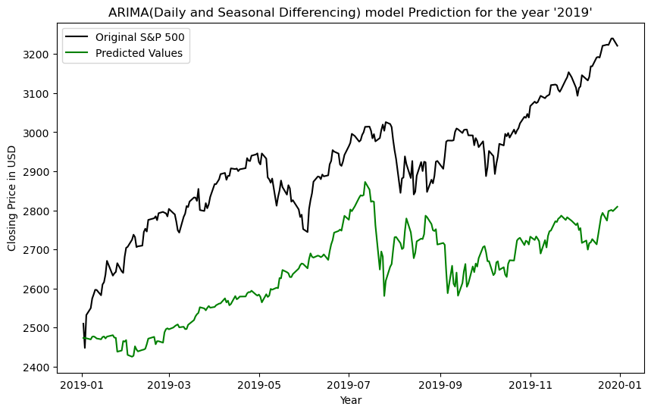
ARIMA
Model
Evaluation

Slide 14
SARIMA
ARIMA

Slide 15
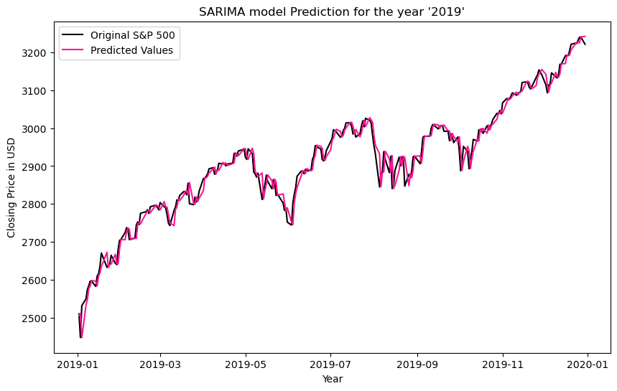
ARIMA
LSTM
SARIMA

Slide 16
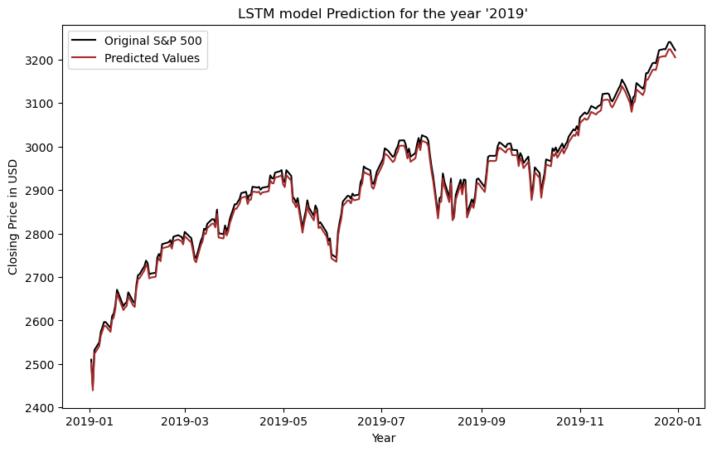
PROPHET
SARIMA
LSTM

Slide 17
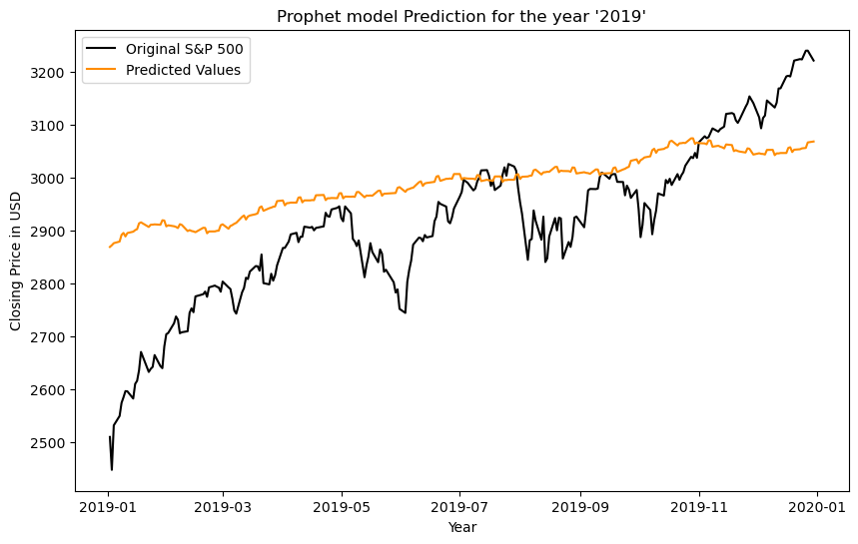
LSTM
SARIMA
PROPHET
Conclusion

Slide 18
PROPHET
Conclusion

